Slide 1
INDIA
LOK SABHA ELECTION
RESULT ANALYSIS
2024
SQL PROJECT

Slide 2



Introduction
1
This project focuses on analyzing the results of the India Lok Sabha Elections 2024 using SQL. The analysis aims to provide key insights into various aspects of the election outcomes, offering a comprehensive understanding of the data.
The analysis begins by exploring the total seats contested across the country, providing a clear picture of the overall electoral landscape. Further, the project dives deeper into the state-wise distribution of seats, highlighting the number of constituencies available for elections in each state.
A key focus of the analysis is understanding the margin of victory for different constituencies and states. By examining close contests and landslide victories, this analysis sheds light on voter preferences and the competitiveness of the elections.
This project uses SQL to extract, clean, and analyze data, ensuring accurate and insightful results. The findings aim to assist in identifying voting patterns, state-level dynamics, and other critical electoral insights in a clear and concise manner.

Slide 3
Problem Statement
2
Total Seats
What are the Total number of seats available for elections in each state
Total Seats Won by NDA Alliance
Seats Won by NDA Alliance Parties
Total Seats Won I.N.D.I.A Alliance
Seats Won by I.N.D.I.A Alliance Parties
Add new column field in table partywise_results to get the Party Alliance as N.D.A, I.N.D.I.A and OTHER
Which Party Alliance (NDA, I.N.D.I.A, or OTHER) won the most seats across all states?

Slide 4
Introduction
1
This project focuses on analyzing the results of the India Lok Sabha Elections 2024 using SQL. The analysis aims to provide key insights into various aspects of the election outcomes, offering a comprehensive understanding of the data.
The analysis begins by exploring the total seats contested across the country, providing a clear picture of the overall electoral landscape. Further, the project dives deeper into the state-wise distribution of seats, highlighting the number of constituencies available for elections in each state.
A key focus of the analysis is understanding the margin of victory for different constituencies and states. By examining close contests and landslide victories, this analysis sheds light on voter preferences and the competitiveness of the elections.
This project uses SQL to extract, clean, and analyze data, ensuring accurate and insightful results. The findings aim to assist in identifying voting patterns, state-level dynamics, and other critical electoral insights in a clear and concise manner.

Slide 5
Entity Relationship Diagram
4
Partywise_results
Party
Won
Party ID
states
State ID
State
Party ID
statewise_results
Contituency
Const. No.
Parliament Contituency
Leading Candidate
Trailing Candidate
Margin
Status
State ID
State
constituencywise_details
Candidate
Party
EVM Votes
Postal Votes
Total Votes
% of Votes
Constituency_ID
constituencywise_results
Parliament Contituency
Constituency Name
Winning Candidate
Total Votes
Margin
Contituency ID
Party ID
Parliament
Contituency
Constituency ID
State ID

Slide 6
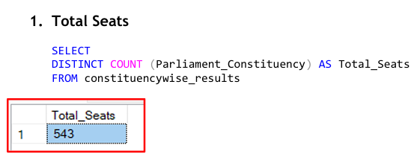
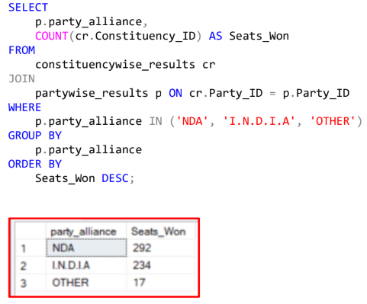
Key SQL Queries and Insights
3
Total Seats:
Which party alliance (NDA, I.N.D.I.A, or OTHER) won the most seats across all states?
Here are a few key SQL queries showcasing the analysis. For the complete set of queries, please refer to the PDF document linked below.
SQl_Query_pdf

Slide 7
Key Findings
5
Overall Seat Distribution
Total Seats Contested: 543
Seats Won by NDA Alliance: 292
Seats Won by I.N.D.I.A Alliance: 234
Seats Won by Others: 17
Summary: This analysis highlights the overall performance of alliances and parties, providing a clear picture of the electoral outcomes. It is essential for understanding coalition strengths and the balance of power in the Lok Sabha.
In-Depth Analysis: Victory Margins and Candidate Insights
Identified winning candidate names, their party affiliation, total votes secured, and margin of victory for specific constituencies and states.
Analyzed the distribution of EVM votes versus postal votes for candidates in a specific constituency to understand voting trends.
Summary: This analysis highlights the overall performance of alliances and parties, providing a clear picture of the electoral outcomes. It is essential for understanding coalition strengths and the balance of power in the Lok Sabha.
State-Level Party Performance
Found which parties won the most seats in each state and the exact number of seats won by each party.
Summary: State-wise analysis provides valuable insights into regional dynamics and the dominance of specific parties in particular states. This is crucial for analyzing the electoral strongholds of alliances and parties.

Slide 8
Conclusion
6
Project Summary
This project successfully analyzed the 2024 Lok Sabha Election results by leveraging SQL to extract and interpret complex datasets. The analysis focused on understanding electoral trends across states, constituencies, and alliances. With well-defined queries, we were able to seamlessly fetch detailed information such as the total number of seats, state-wise seat distribution, winning margins, and much more.
The structured database design and SQL queries made it easy to fetch data for any individual state, constituency, or alliance. This streamlined approach simplifies complex electoral data and provides a comprehensive view of election dynamics.
Key Takeaways and Recommendations
Key Insights
State-wise Performance: Identified how many seats each party and alliance won in each state, highlighting regional strongholds.
Victory Margins: Analyzed close contests and landslide victories to understand voter preferences.
Voting Trends: Studied the share of EVM votes and postal votes for better insights into voting patterns.
Recommendations
Focus on Close Contests: Strengthen campaigns in constituencies with narrow victory margins.
Boost Voter Engagement: Improve voter turnout in areas with low participation.
Use for Predictions: Apply findings to forecast future election outcomes and improve strategic planning for parties and alliances.

Slide 9
THANK YOU

